Slide 1
ECE 476
Power System Analysis
Lecture 18: Optimal Power Flow (OPF),
Short Circuit
Prof. Tom Overbye
Dept. of Electrical and Computer Engineering
University of Illinois at Urbana-Champaign
overbye@illinois.edu

Slide 2
Announcements
Please read Chapters 7 and 8
HW 7 is 6.62, 6.63, 6.69, 6.71 due on Oct 27; this one must be turned in on Oct 27 (hence there will be no quiz that day)
Optional Reading: Analytic Research Foundations for the Next-Generation Electric Grid, The National Academies Press, 2016
Exam 2 is during class on Tuesday November 15
Final exam is on Monday December 12, 1:30-4:30pm

Slide 3
Calculation of Penalty Factors
2

Slide 4
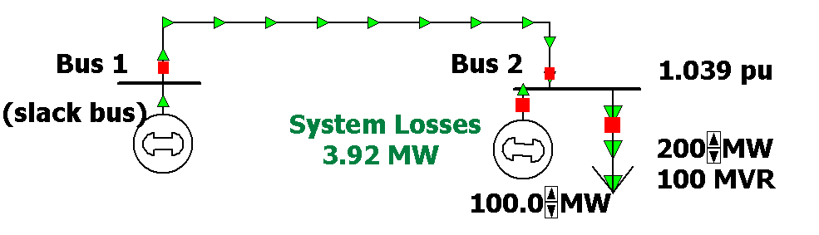
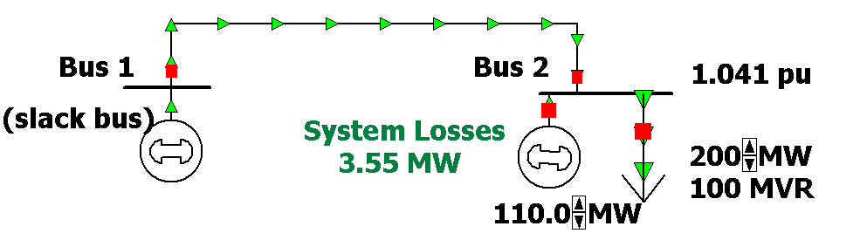
Two Bus Penalty Factor Example
3

Slide 5
Example 6.22

Slide 6
Optimal Power Flow (OPF)
OPF functionally combines the power flow with economic dispatch
Minimize cost function, such as operating cost, taking into account realistic equality and inequality constraints
Equality constraints
  bus real and reactive power balance
  generator voltage setpoints
  area MW interchange
5

Slide 7
OPF, cont’d
Inequality constraints
  transmission line/transformer/interface flow limits
  generator MW limits
  generator reactive power capability curves
  bus voltage magnitudes (not yet implemented in Simulator OPF)
Available Controls
  generator MW outputs
  transformer taps and phase angles
6

Slide 8
Two Example OPF Solution Methods
Non-linear approach using Newton’s method
  handles marginal losses well, but is relatively slow and has problems determining binding constraints
Linear Programming
  fast and efficient in determining binding constraints, but can have difficulty with marginal losses.
  used in PowerWorld Simulator
7

Slide 9
LP OPF Solution Method
Solution iterates between
  solving a full ac power flow solution
    enforces real/reactive power balance at each bus
    enforces generator reactive limits
    system controls are assumed fixed
    takes into account non-linearities
  solving a primal LP
    changes system controls to enforce linearized constraints while minimizing cost
8

Slide 10
Two Bus with Unconstrained Line
With no overloads the
OPF matches
the economic
dispatch
Transmission line is not overloaded
Marginal cost of supplying
power to each bus (locational marginal costs)
9

Slide 11
Two Bus with Constrained Line
With the line loaded to its limit, additional load at Bus A must be supplied locally, causing the marginal costs to diverge.
10

Slide 12
Three Bus (B3) Example
Consider a three bus case (bus 1 is system slack), with all buses connected through 0.1 pu reactance lines, each with a 100 MVA limit
Let the generator marginal costs be
  Bus 1: 10 $ / MWhr; Range = 0 to 400 MW
  Bus 2: 12 $ / MWhr; Range = 0 to 400 MW
  Bus 3: 20 $ / MWhr; Range = 0 to 400 MW
Assume a single 180 MW load at bus 2
11

Slide 13
B3 with Line Limits NOT Enforced
Line from Bus 1
to Bus 3 is over-
loaded; all buses
have same
marginal cost
12

Slide 14
B3 with Line Limits Enforced
LP OPF redispatches
to remove violation.
Bus marginal
costs are now
different.
13

Slide 15
Verify Bus 3 Marginal Cost
One additional MW
of load at bus 3
raised total cost by
14 $/hr, as G2 went
up by 2 MW and G1
went down by 1MW
14

Slide 16
Why is bus 3 LMP = $14 /MWh
All lines have equal impedance. Power flow in a simple network distributes inversely to impedance of path.
  For bus 1 to supply 1 MW to bus 3, 2/3 MW would take direct path from 1 to 3, while 1/3 MW would “loop around” from 1 to 2 to 3.
  Likewise, for bus 2 to supply 1 MW to bus 3, 2/3MW would go from 2 to 3, while 1/3 MW would go from 2 to 1to 3.
15

Slide 17
Why is bus 3 LMP $ 14 / MWh, cont’d
With the line from 1 to 3 limited, no additional power flows are allowed on it.
To supply 1 more MW to bus 3 we need
  Pg1 + Pg2 = 1 MW
  2/3 Pg1 + 1/3 Pg2 = 0; (no more flow on 1-3)
Solving requires we up Pg2 by 2 MW and drop Pg1 by 1 MW -- a net increase of $14.
16

Slide 18
Both lines into Bus 3 Congested
For bus 3 loads
above 200 MW,
the load must be
supplied locally.
Then what if the
bus 3 generator
opens?
17

Slide 19
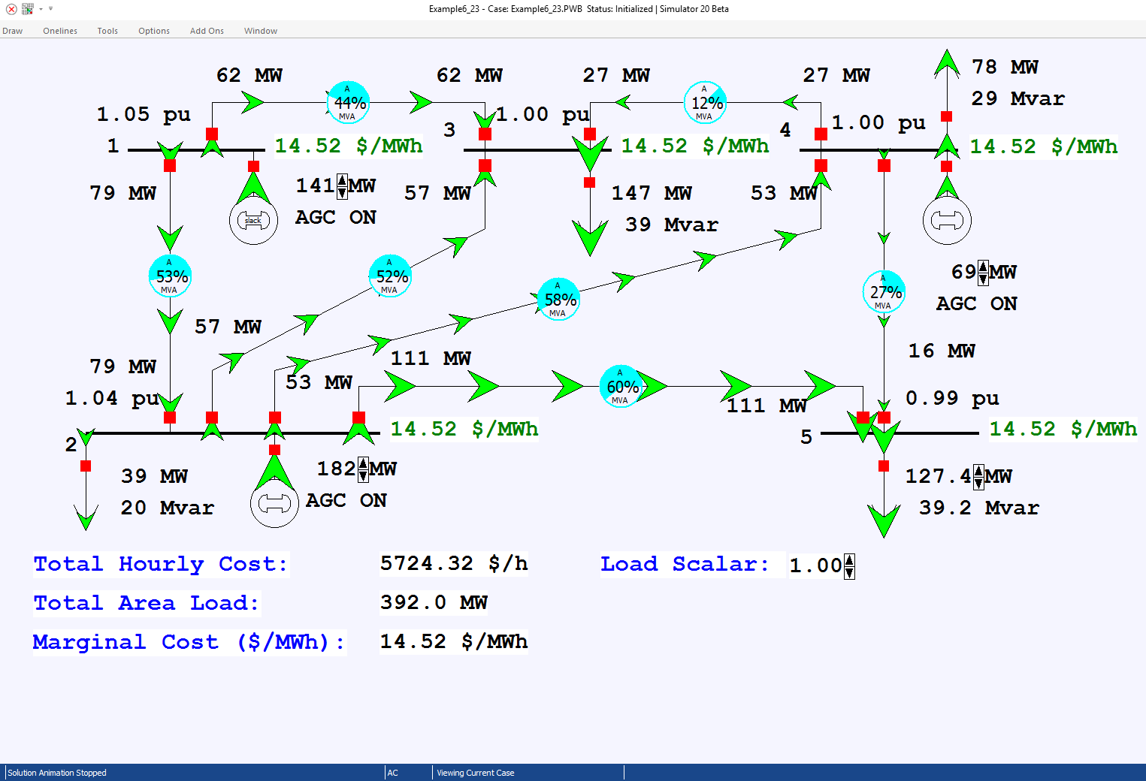
Example 6_23 Optimal Power Flow

Slide 20
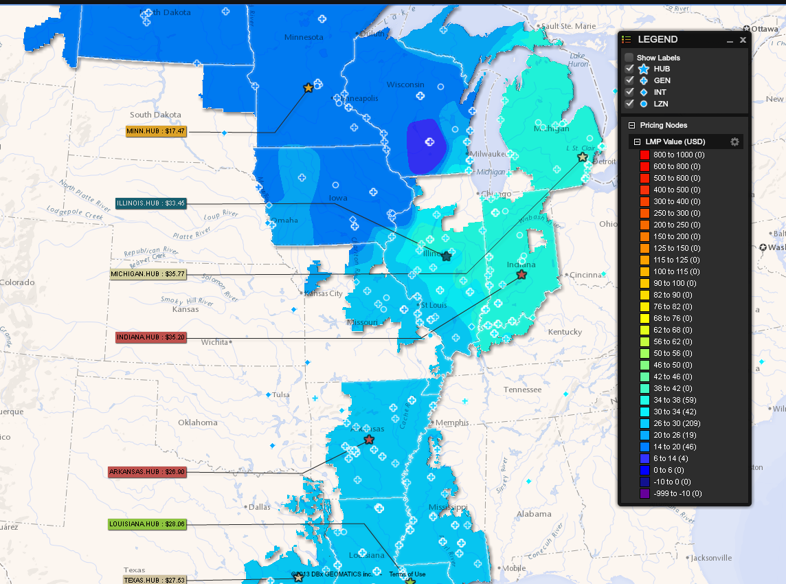
MISO LMP Price Contour:
830am CDT Oct 24, 2016
Image Source: www.misoenergy.org/LMPContourMap/MISO_All.html
19

Slide 21
Power Markets (Sometimes Known as Independent System Operator)
In many places markets are replacing many of the former planning and operation tools and functions
  MISO is an example of a such a market
Goal is to replace regulated cost-plus system with competitive marketplaces
  underlying assumption is in the long-run with competition prices should decrease
  market should be designed so participants do not have to provide their true costs to a central authority
Markets differ widely in what functions they provide
20

Slide 22
Example Energy Market
.
.
.
.
.
.
Seller 1
Seller i
Seller M
MWh
$
MWh
$
MWh
$
Market Operator
MWh
$
MWh
$
MWh
$
.
.
.
.
.
.
Buyer 1
Buyer j
Buyer N
21

Slide 23
Need to Approximate Gen Curves
Actual
curve is
approximated
with a
piecewise
linear
curve
22

Slide 24
Market Receives Offers for Each Unit
Unit 1 Offers
23

Slide 25
Composite Offers for One Period
24

Slide 26
Dispatch by Auction
In its simplest form, an auction is a mechanism of allocating scarce goods based upon competition
  a seller wishes to obtain as much money as possible, and a buyer wants to pay as little as necessary.
An auction is usually considered efficient if resources accrue to those who value them most highly
Auctions can be either one-sided with a single monopolist seller/buyer or a double auction with multiple parties in each category
25

Slide 27
Auctions, cont’d
In an auctions buyers make bids to buy, while sellers make offers to sell.
The job of an auction is to provide a mechanism for participants to reveal their true costs while satisfying their desires to buy low and/or sell high.
Auctions differ on the price participants receive and how much information they see along the way
26

Slide 28
Uniform Price Auctions
Uniform price auctions are sealed offer auctions in which sellers make simultaneous decisions (done when they submit their offers).
Generators can be paid either the last accepted offer (LAO) or paid the first rejected offer (FRO)
This provides incentive to offer at marginal cost, since higher values could cause offers to be rejected
  thus reigning price should be a reliable signal of marginal cost
Price caps are needed to prevent prices from rising up to infinity when there is limited supply
27

Slide 29
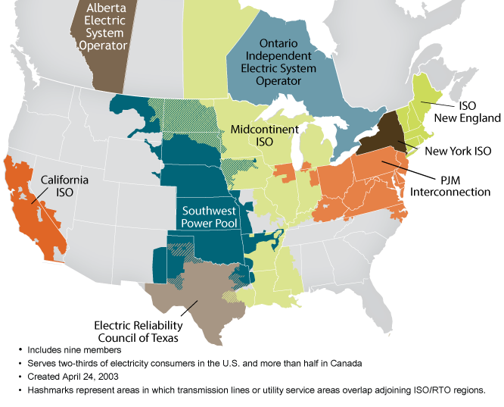
North American ISO/RTO
Image Source: www.isorto.org

Slide 30
Fault Analysis
The cause of electric power system faults is insulation breakdown
This breakdown can be due to a variety of different factors
  lightning
  wires blowing together in the wind
  animals or plants coming in contact with the wires
  salt spray or pollution on insulators
29

Slide 31
Fault Types
There are two main types of faults
  symmetric faults: system remains balanced; these faults are relatively rare, but are the easiest to analyze so we’ll consider them first.
  unsymmetric faults: system is no longer balanced; very common, but more difficult to analyze
The most common type of fault on a three phase system by far is the single line-to-ground (SLG), followed by the line-to-line faults (LL), double line-to-ground (DLG) faults, and balanced three phase faults
30

